Slide 1
Simple Linear Regression
LECTURE 15
Introducing a more nuanced model.
Sean Kang

Slide 2
Recap: Modeling

Slide 3
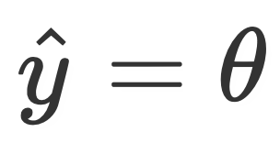

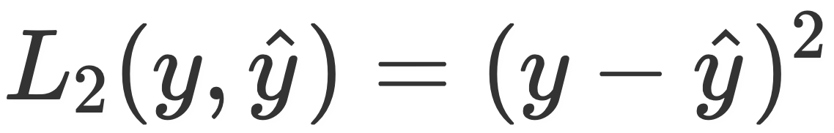
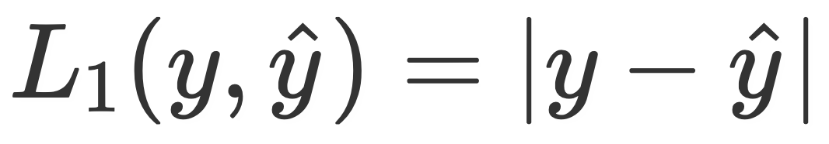
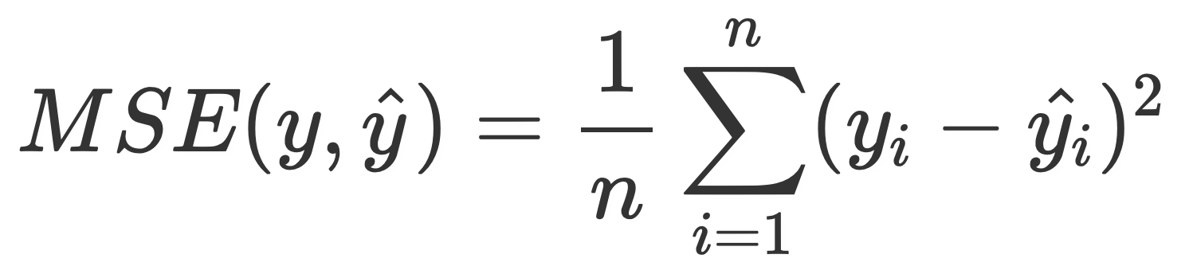
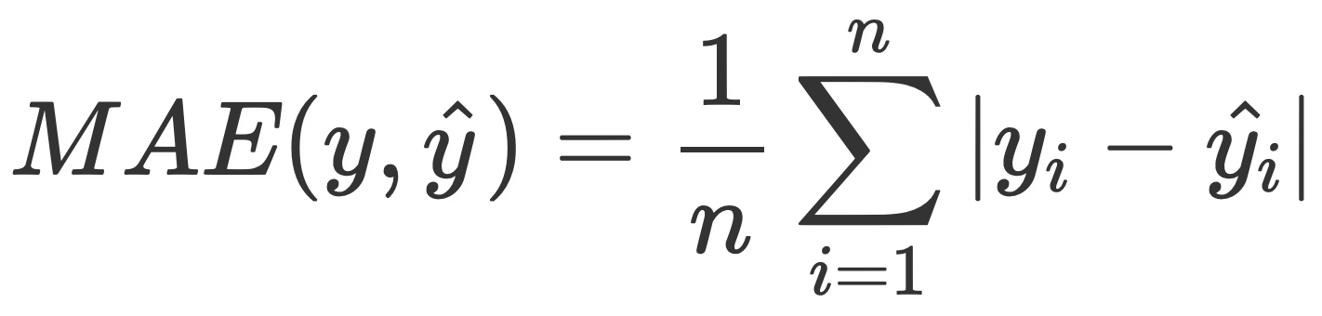
Recap of the modeling process
Choose a model.
So far, we’ve seen the constant model .
(theta) is called a parameter.
Choose a loss function.
So far, the options have been squared loss or absolute loss.
Squared loss: .
Absolute loss: .
Loss functions tell us how much to penalize a single prediction.
Minimize average loss across our entire dataset, to determine the optimal parameters.
Smaller average loss values mean a better fit; thus, we find the parameters that minimize average loss.
Notes:
3 step modelling process: defining a model, defining a loss function, minimizing avg loss to fit our model to the data
Looked at constant model: theta as single scalar value, parameters defines predictions our model makes
Loss functions tell us how good or bad a single prediction was for one observation in our dataset
If y-hat is close to the true value our loss will be low, otherwise it will be high
Want model that best fits entire dataset NOT just a single observation
Minimize avg loss across entire dataset to find the model the best fits the data

Slide 4
Correlation

Slide 5
Exploring relationships between two variables
The constant model we saw in the last lecture was only able to capture the distribution of a single variable. It was a summary statistic.
More commonly, we create models that try to explain the relationships between multiple variables (which we will now denote with x and y).
When using the Tips dataset as a motivator in the last lecture, we looked at a histogram of the data (with an overlaid KDE).
When we have two continuous variables, we have several choices.
Scatter plot. These are the simplest choice.
Hexbin plot.
Contour plot.

Slide 6
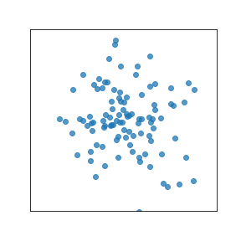
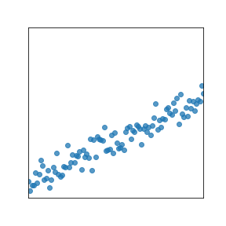
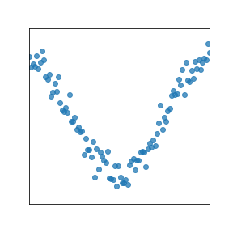
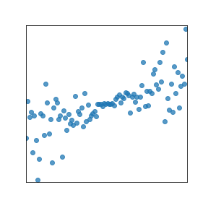
Exploring relationships between two variables
Looks like random noise.
Looks like there’s a strong linear relationship between x and y.
Looks like x and y are related, but not linearly.
Looks like there’s somewhat of a linear relationship, but the points are more spread out away from the center.
Notes:
We care a lot about linear relationships, because we understand linear models so well.

Slide 7
Correlation coefficient
The Pearson’s correlation coefficient (r) measures the strength of the linear association between two variables.
It is a unitless quantity.
It ranges between -1 and 1.
r = 1 indicates a perfect positive linear association (x and y lie exactly on a straight line that is sloped upwards).
r = -1 indicates a perfect negative linear association between x and y.
The closer r is to 0, the weaker the linear association between x and y is.
It says nothing about causation or non-linear association.
Even if r = 1, it does not mean that x causes y! Correlation does not imply causation.
When r = 0, we say our two variables are uncorrelated. They could be related through some non-linear association, though.
Very sensitive to outliers.
Notes:
You should have seen this quantity in Data 8. That’s why this slide is quite dense.
Sometimes called Pearson’s coefficient r.
What is an input variable into an event that has no bearing on the output ? No causation

Slide 8
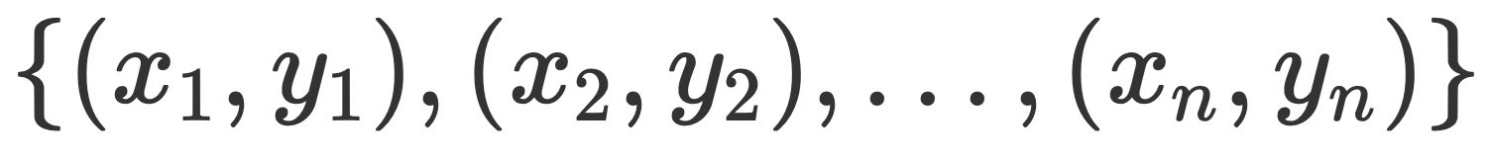
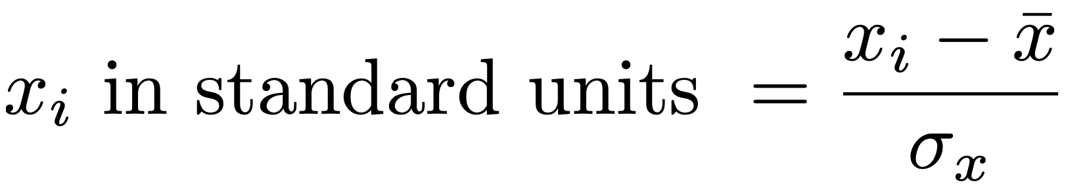
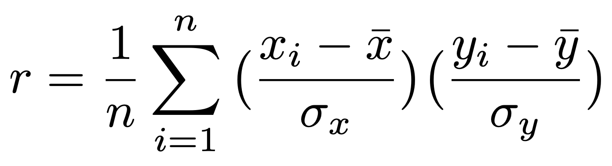
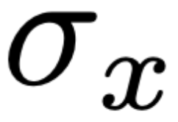
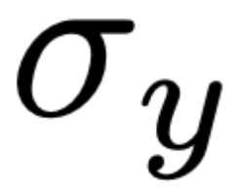
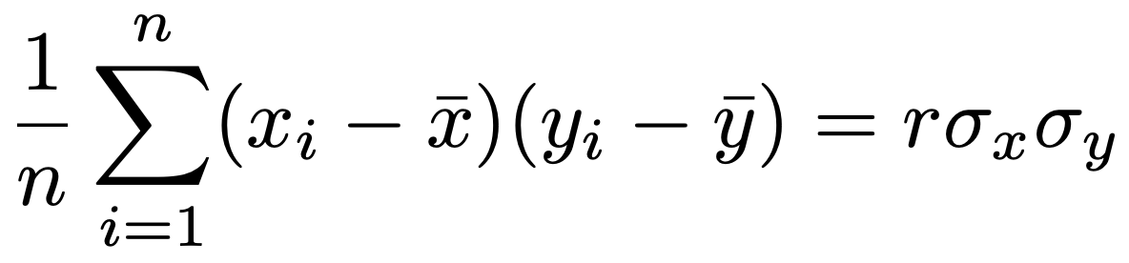
Correlation coefficient
From Data 8: r is the average of the product of x and y, both measured in standard units.
Suppose our data looks like . Then, .
We then have:
Note: Since and are constants, we can pull them out of the sum, and write
This quantity is called the covariance of two variables.
average
product
The average product of deviations
Notes:
What happens if x_i = y_i? Then, the left hand side evaluates to the variance of the xs, and the right hand side evaluates to 1 * (sigmax)^2 – which is also the variance of the xs!

Slide 9
Correlation coefficient
r = -0.121
r = 0.949
r = 0.052
r = 0.704
Notes:
Revisiting our example plots from before.

Slide 10
Simple linear regression

Slide 11
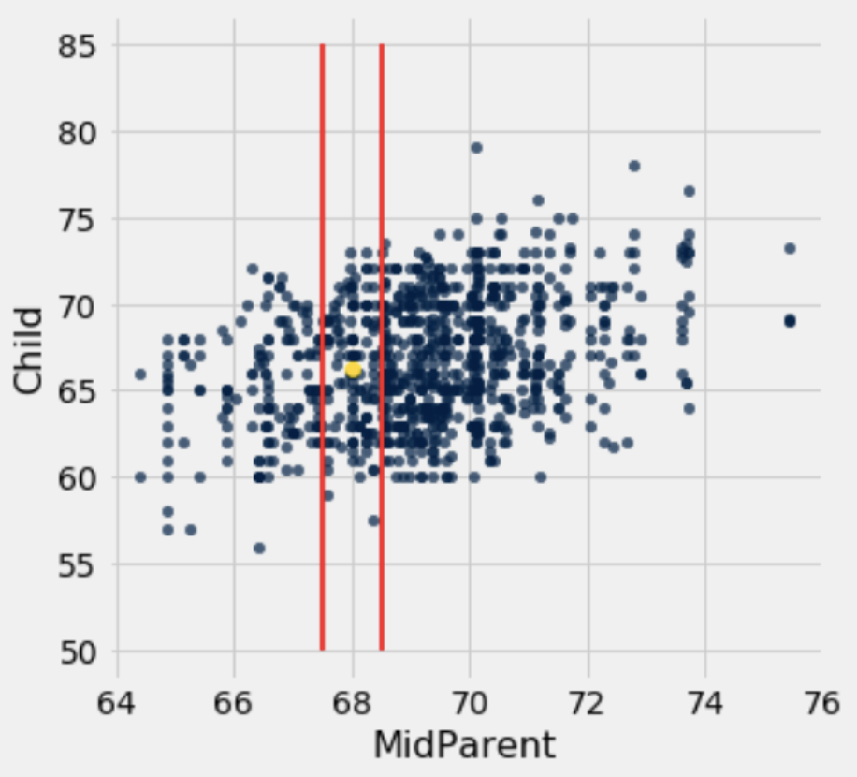
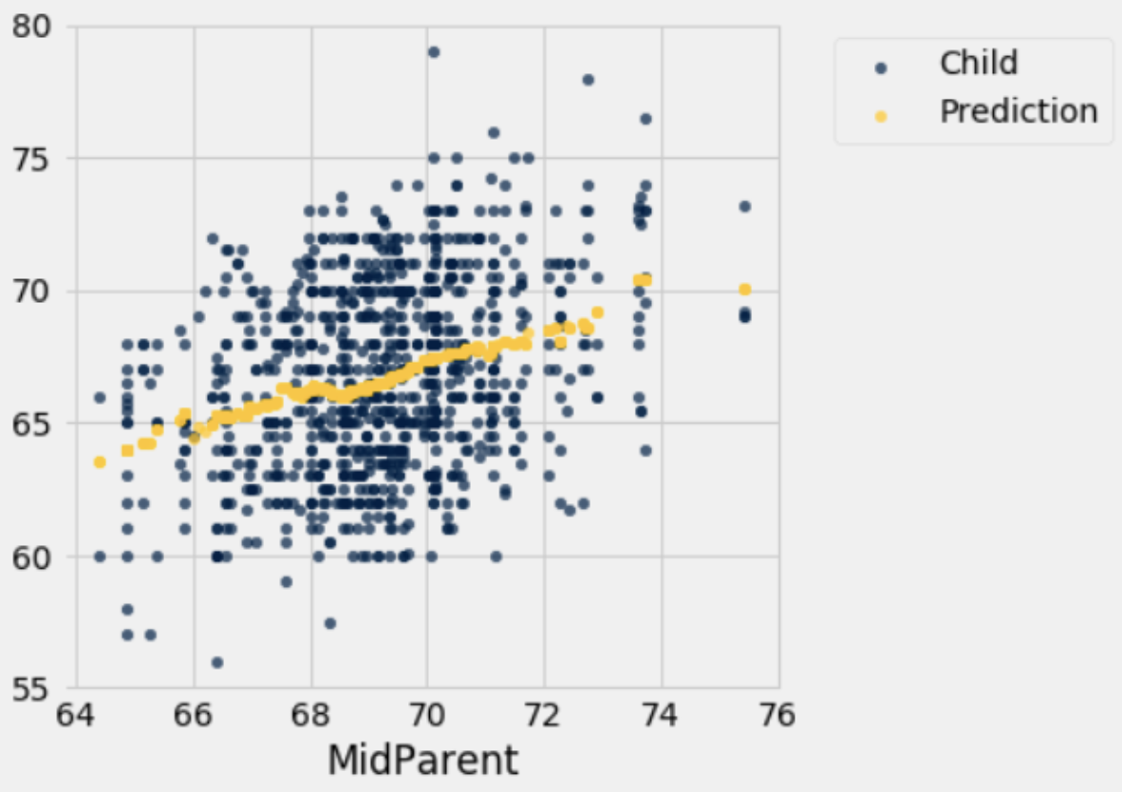
Graph of averages
Suppose we want to now predict the value of y, for any given x. One reasonable thing to do might be to compute the average value of y for each x, and predict that.
Doing this yields predictions that look like a line. So, let’s model this relationship with a line!
Bucket the x-axis into bins.
Notes:
Why is the average value of y a good measure? Well, we just showed in the last lecture that the mean minimizes MSE!

Slide 12
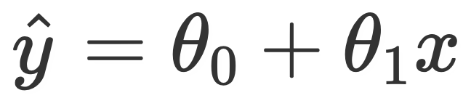
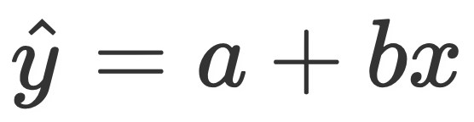
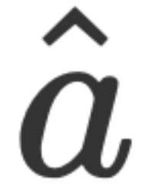

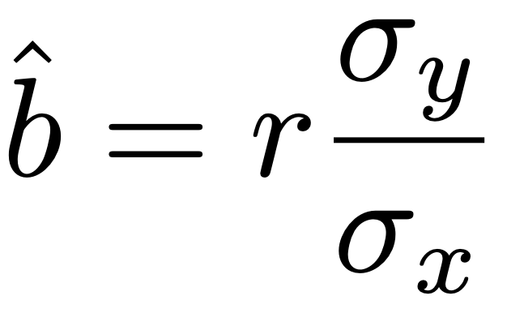
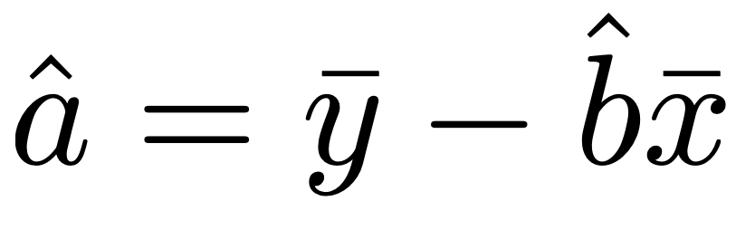
Equation of the regression line
A simple linear model (with a slope and intercept) is of the form
Note, we have two parameters now. For simplicity’s sake, we will instead say (for now): (lab)
We call this the simple linear regression model.
To determine the optimal model parameters and , we need to choose a loss function. Choosing squared loss (and hence MSE) gives the following optimal parameters:
Note: these are defined in terms of the correlation coefficient, r!
Notes:
Look at slope and intercept function in lab

Slide 13
Equation of the regression line
Let’s look at a demo. Specifically, we’ll:
Create the graph of averages you saw before.
Implement the optimal parameters by hand.
In the future, we will resort to in-built packages to do this for us.

Slide 14
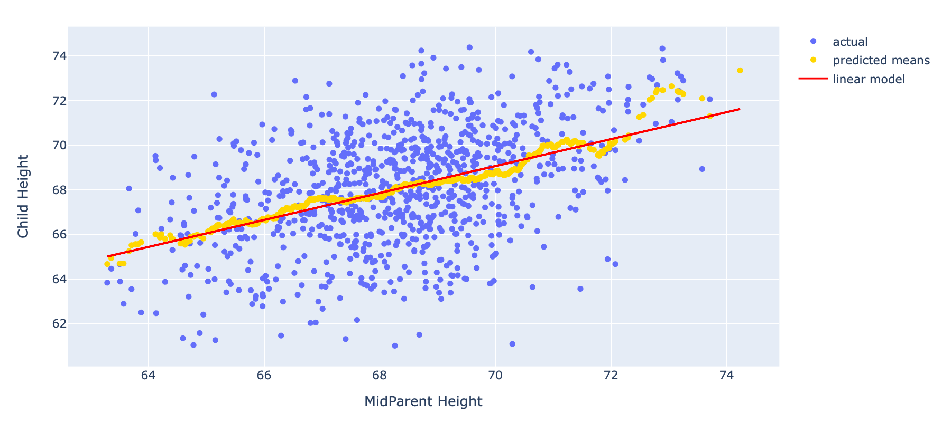
Our linear model matches the predicted means quite well.

Slide 15
Minimizing MSE for the SLR model

Slide 16
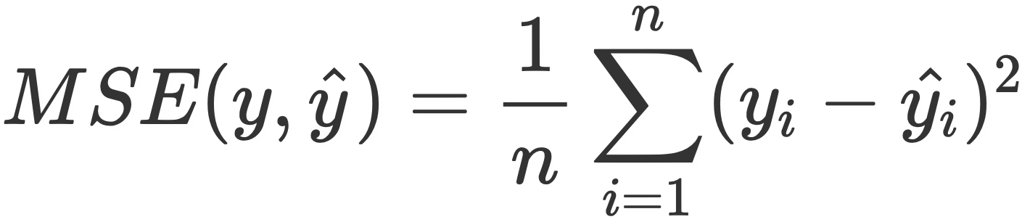
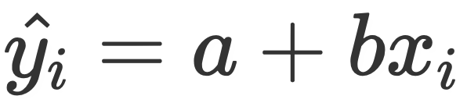
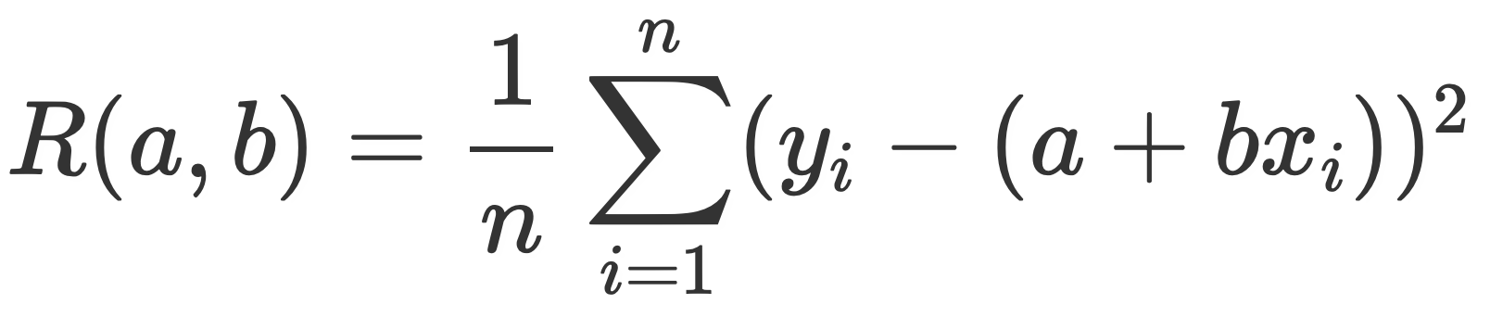
Minimizing MSE for the SLR model
We will now walk through the calculus of determining the optimal parameters for the SLR model, using squared loss. Recall, mean squared error is of the form .
Since our model (for a given observation) is , the quantity we want to minimize is:
Note, there are now two parameters we need to optimize over. We want the best combination of a and b such that average loss is minimized.
This gives us a model that fits the data as best as possible.
We refer to this combination of model and loss as “least squares linear regression.”

Slide 17
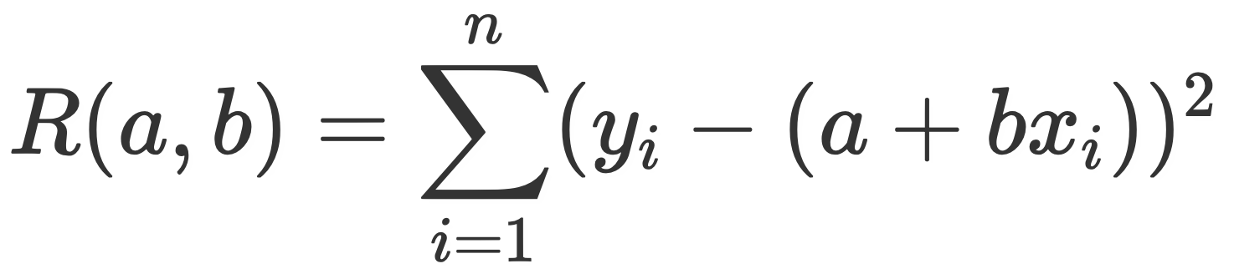
Minimizing MSE for the SLR model
One slight simplification we can make: the pair (a, b) that minimizes is also the same pair (a, b) that minimizes
The value of the objective function will be different, but what we’re looking for are the optimal parameters. Those won’t change when we multiply the function by a constant.
To determine the pair (a, b) that minimizes our objective function, we need to take partial derivatives with respect to both parameters (a, b), set them equal to 0, and solve both equations.
Remember, our data points are constants here – they are not variables!
The video for this lecture walks through all of the steps in the next slide(s) in depth.

Slide 18
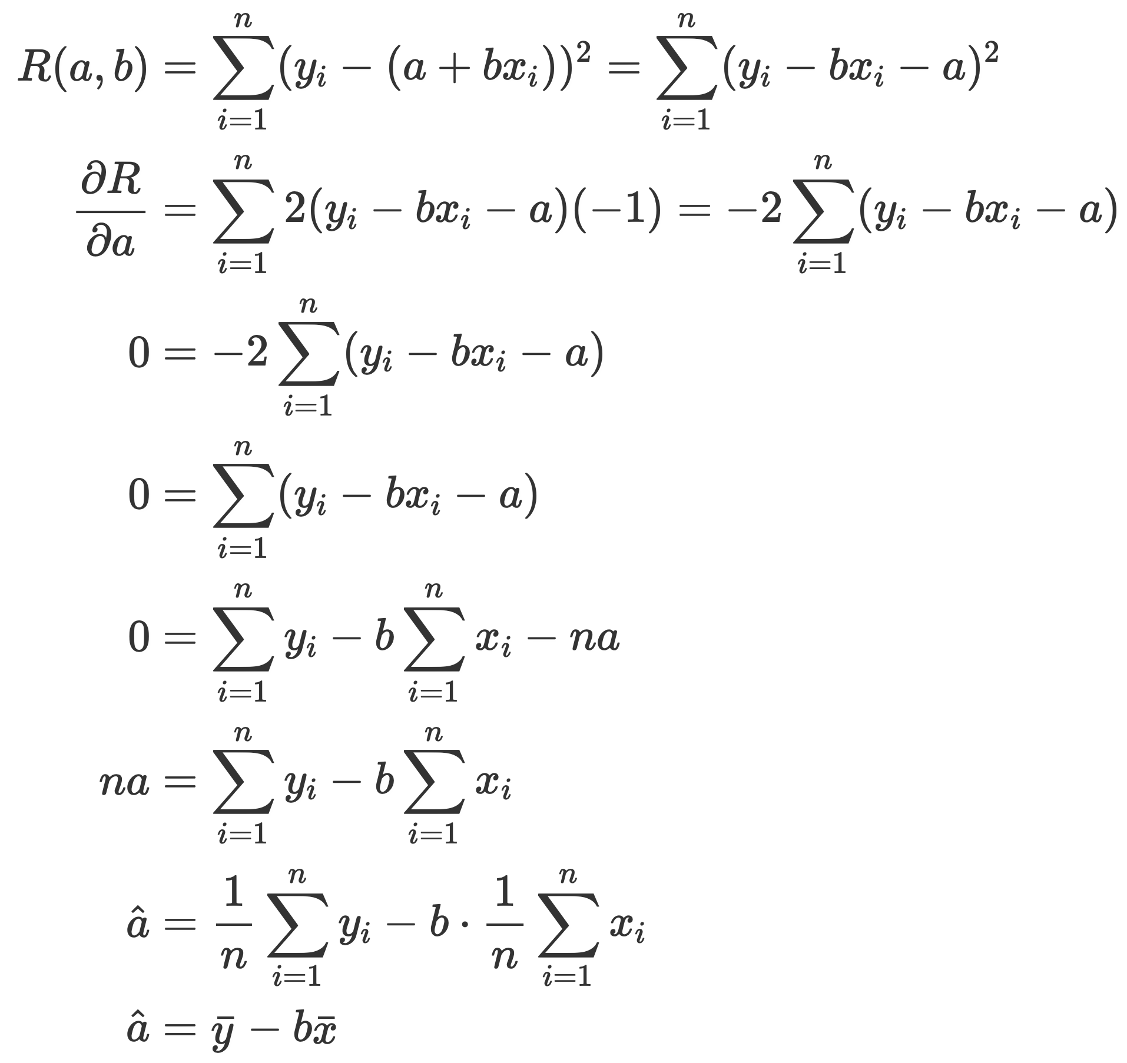
Minimizing MSE for the SLR model
First, we rearrange our objective function to be slightly more convenient. We then take the derivative with respect to a, and set it equal to 0.
Then, using the properties of summations, we rearrange to solve for . Note, this is in terms of our choice of b.
We now need to substitute this value into the objective function when we solve for the optimal b.

Slide 19
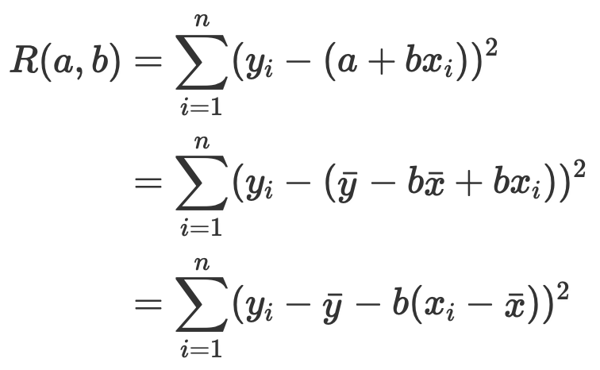
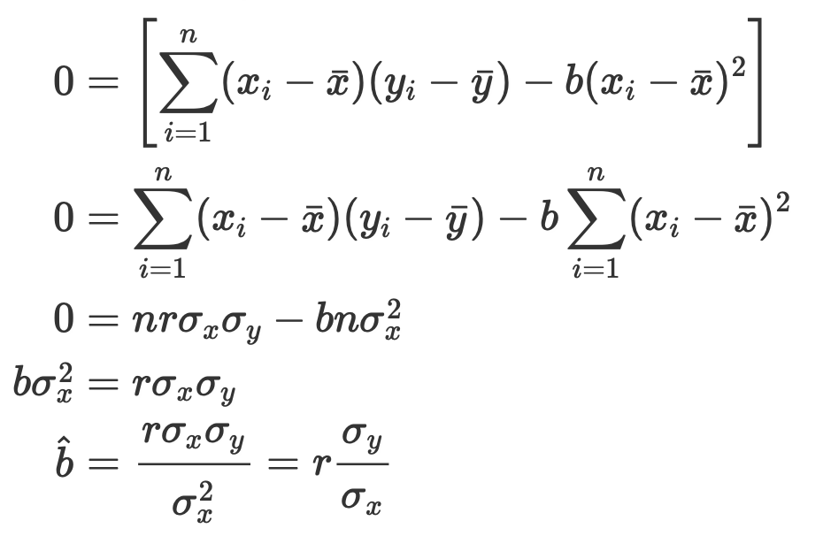
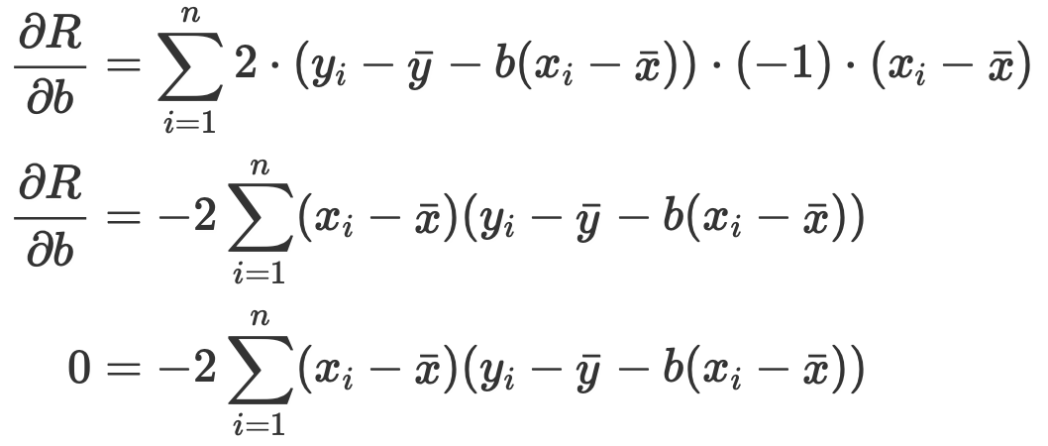
Minimizing MSE for the SLR model
First, we substitute our expression for into the objective function:
And finally, we rearrange and solve for :
Then, we take the partial derivative w.r.t. b and set it to 0:
Looks familiar!

Slide 20
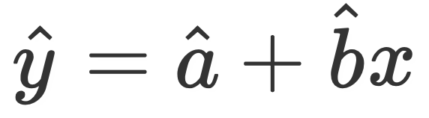
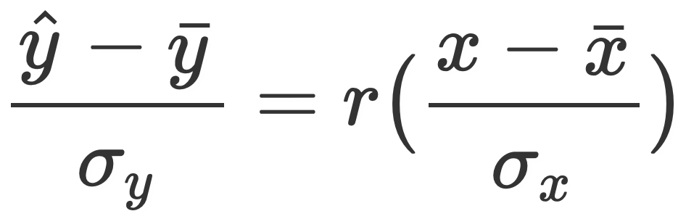
Minimizing MSE for the SLR model
We’ve now shown that when using squared loss as our loss function, the optimal parameters for the model are given by
If we used a loss function other than squared loss, we’d end up with different optimal parameters!
This process of determining optimal model parameters by hand is something you should be able to do on your own.
Change the model, change the loss, and try it yourself!
Note: We can also rewrite our model as follows, showing that r is the slope of the regression line in standard units:

Slide 21
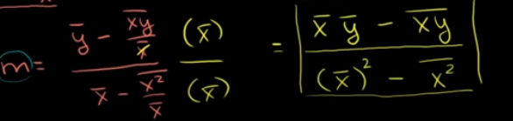
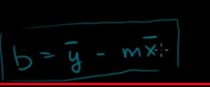
Minimizing MSE using Algebra
Look at demo file for how to use this
Notes:
https://www.khanacademy.org/math/statistics-probability/describing-relationships-quantitative-data/more-on-regression/v/regression-line-example
https://www.khanacademy.org/math/statistics-probability/describing-relationships-quantitative-data/more-on-regression/v/squared-error-of-regression-line

Slide 22
Links for the video
link1
link2

Slide 23
Visualizing loss surfaces

Slide 24
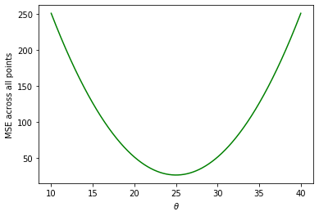
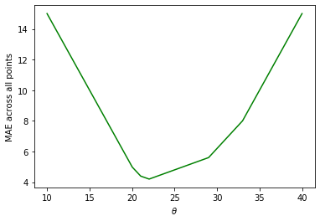
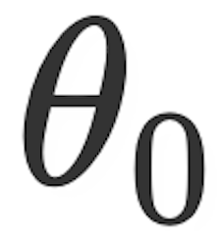
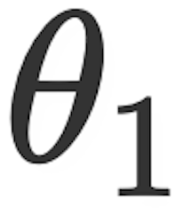
Visualizing loss surfaces
On the left, we have the plots of the loss surfaces for the constant model (from last lecture).
Top: squared loss (so average loss = MSE).
The y-axis shows the MSE for each value of theta on the x-axis.
Bottom: absolute loss (so average loss = MAE).
The simple linear regression model has two parameters, a and b (or equivalently, and ). This means the loss surface will be 3D!

Slide 25
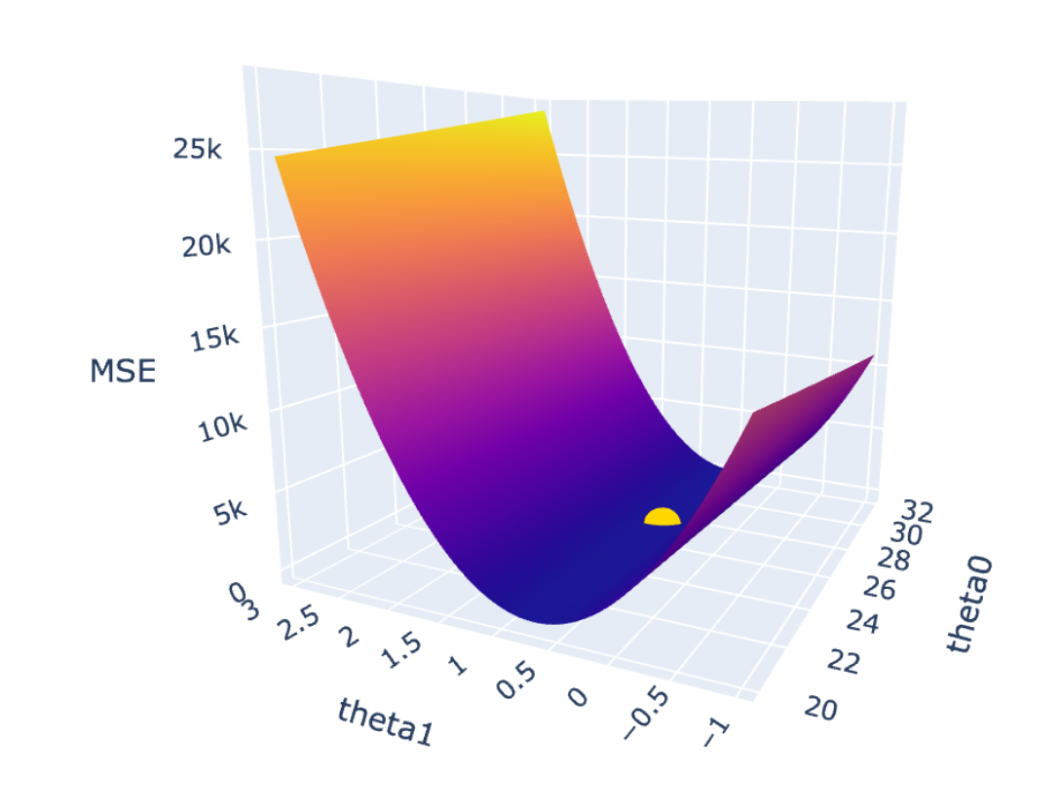
Visualizing loss surfaces
The yellow point denotes the minimum, which occurs at the point we determined algebraically.
Here, we have 3 axes.
One for .
One for .
One that tells us the mean squared error on our dataset, using the model .
The loss surface is nice and smooth (which we touted as a property of the squared loss in the last lecture).
Let’s look at a demo of this in code.
Notes:
If you didn’t watch the lecture (sad!) you really should take a look at the supplementary notebook and play around with this plot. When you hover over a certain point, it tells you precisely what the loss for that (theta0, theta1) combination is.

Slide 26
Model interpretation

Slide 27
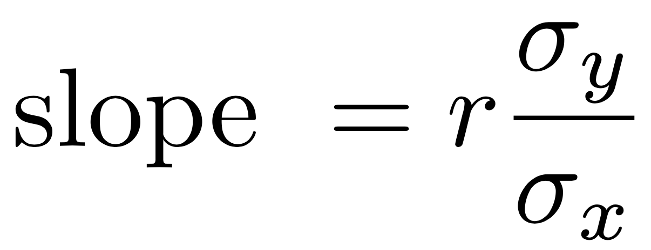
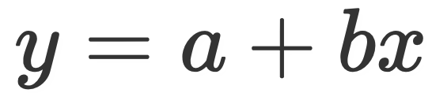
Interpreting slopes
The slope is measured in units of y per unit of x.
For instance, suppose we survey several individuals for their weight and height, and we want to use weight (x) to predict height (y).
Another way of saying this is “regressing height on weight.”
The units of our slope could be inches per pound.
In a standard line , the slope (b) measures the increase in y for a 1 unit increase in x.
Using the above example, suppose our model turns out to be
Predicted Height = 26.5 + 0.61 * PWeight

Slide 28
Interpreting slopes
Predicted Height = 26.5 + 0.61 * PWeight
Does this mean that if someone in the dataset puts on 1 pound, we estimate that they will get 0.61 inches taller? No!
The model we created shows association, not causation.
The data we collected is a snapshot of several people at one instance of time (cross-sectional), not snapshots of people over time (longitudinal).
What does this mean, then?
0.61 inches is the estimated height difference between two people whose weights are one pound apart.

Slide 29
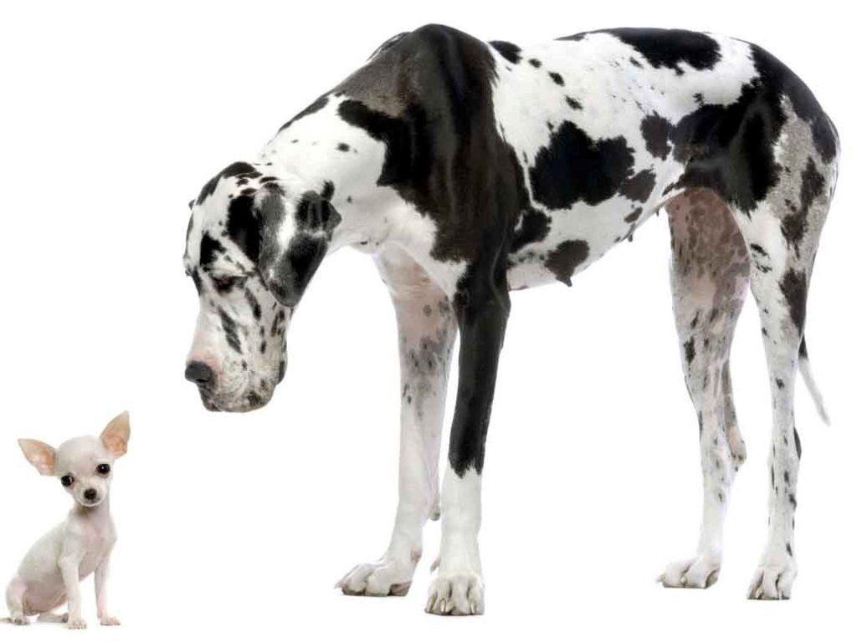
New data needs to be similar to original data
Suppose we fit a model that predicts a Chihuahua’s weight given its length.
Should we use this model to predict the weight of Great Danes?
No – we have no indication that the weight vs. length relationship for Great Danes are the same as Chihuahuas.
Great Danes’ weights and lengths are well outside of the range of weights and lengths we fit our model on.
If the new data we test our model on looks nothing like the data we fit our model on, there’s no guarantee that it will be any good.
This is a notion we will formalize in a few lectures.
Chihuahuas (left) range from 3-6 pounds, and 9.5-15 inches in length. Great Danes (right) range from 110-175 pounds, and 35.5-43 inches in length.
Notes:
This model is completely made up, by the way.

Slide 30
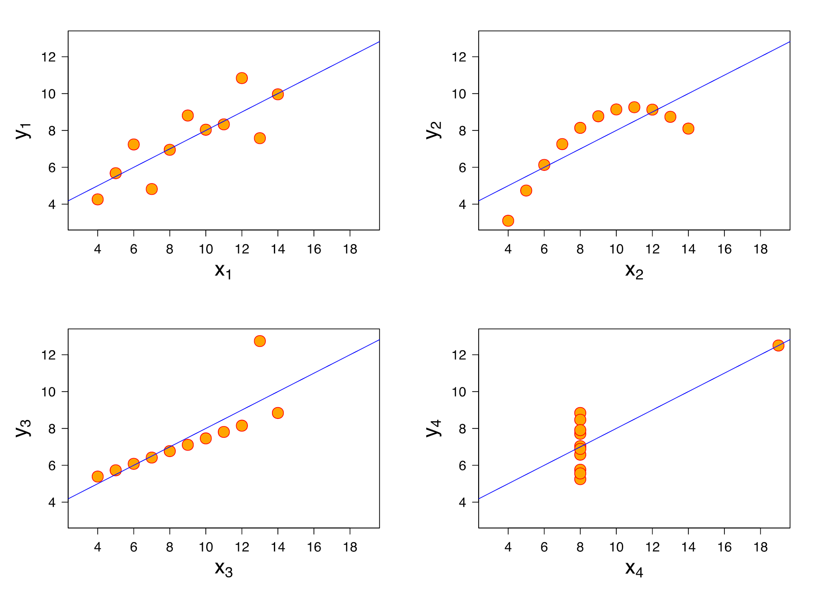
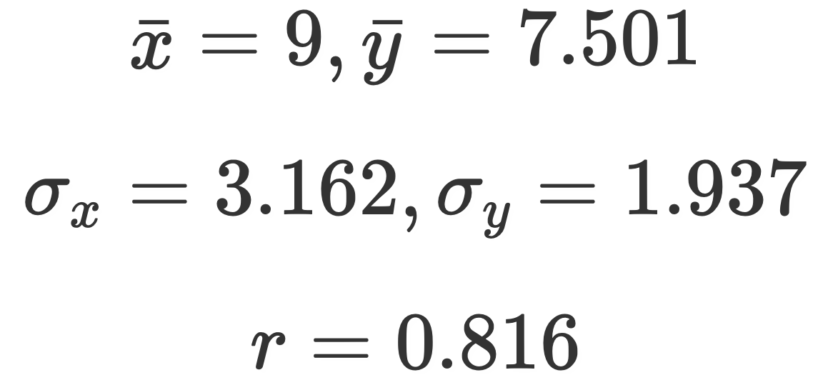
Visualize, then quantify!
Anscombe’s quartet refers to the following four sets of points on the right.
They each have the same mean of x, mean of y, SD of x, SD of y, and r value.
Since our optimal SLR model only depends on those quantities, they all have the same regression line.
However, the SLR model only makes sense as a model for one of these four sets of points.
Before modeling, you should always visualize your data first!

Slide 31
Multiple linear regression

Slide 32
Terminology
There are several equivalent terms in the regression context. You should be aware of them.
Feature (ind var)
Covariate (input var)
Independent variable.
Explanatory variable.
Predictor.
Input.
Regressor
Output.
Outcome.
Response.
Dependent variable.
x
y

Slide 33
Adding independent variables
First, some terminology. For our purposes, all of these terms mean the same thing:
Feature.
Covariate.
Independent variable.
Explanatory variable.
Predictor.
Input.
Regressor.
In the regression context, each of the above things has a “weight” assigned to it, given by the parameter. We also call these weights “coefficients.” For instance, in , we might say the “weight” associated with the constant/intercept term is , and the “weight” associated with the x term is .
Notes:
https://www.youtube.com/watch?v=dQNpSa-bq4M

Slide 34
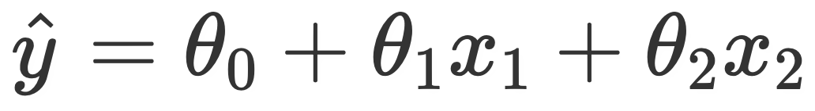
Adding independent variables
A linear regression model with two features (and thus, three parameters), is of the form
For example, suppose we want to create a linear regression model that predicts the number of points a player in the NBA averages (PTS). Using just the number of assists (AST) they average might yield a model of the form
If we use both AST and the number of 3PT field goal attempts they make (3PA), we may have
(These coefficients were determined by minimizing average squared loss, in the companion notebook.)

Slide 35
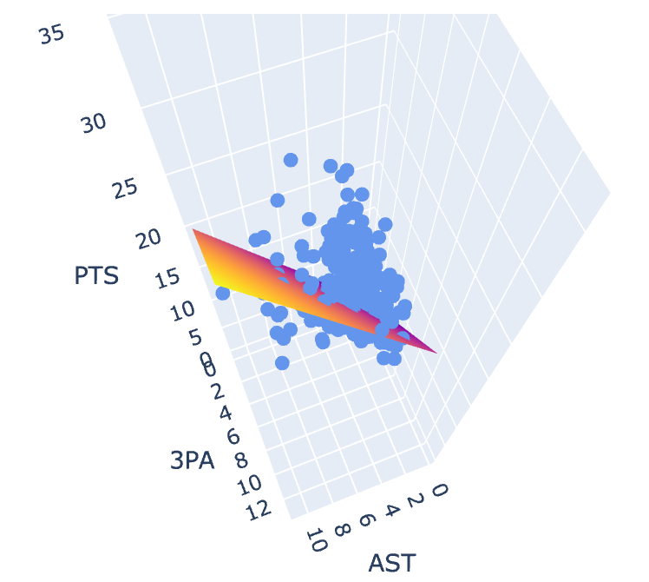
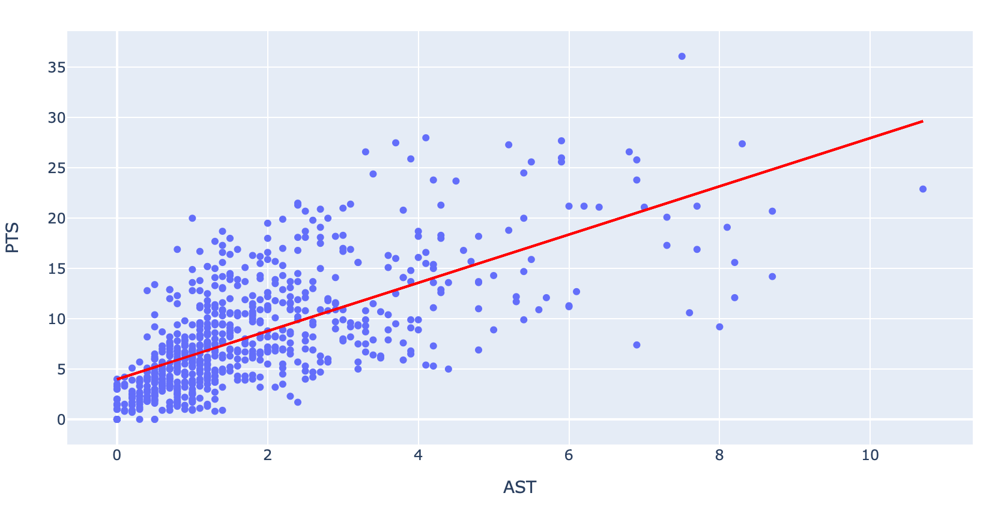
Visualizing higher-dimension models
In both of the below plots, the blue circles represent the true observations.
On the left, the red line represents the model obtained by using only AST.
On the right, since we now have two independent variables, our model is a plane in 3D.

Slide 36
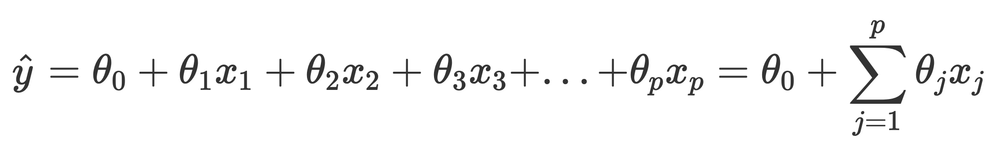
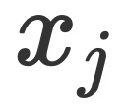



Multiple linear regression
In general, the multiple linear regression model is of the form
We say this model has p features, plus an intercept term.
The weight associated with feature is .
If we set for each observation, then we can simplify further:
This is the notation we will use moving forward.
Think about how you can rewrite this in terms of a vector multiplication!
Be careful: xj here refers to feature j, not data point j.

Slide 37

Multiple linear regression
Model 1:
Model 2:
These are different models! In general, in one model will not be equal to in another model.
2.4 is the slope of the relationship between AST and PTS, when only considering those two variables.
Parameters [3.98, 2.4] minimize average squared loss for Model 1.
1.64 is the slope of the relationship between AST and PTS, when also considering 3PA.
Parameters [2.163, 1.64, 1.26] minimize average squared loss for Model 2.
different!

Slide 38





General notation
Our models can be expressed as a function of an input variable, x.
Constant model:
Simple linear regression model:
Multiple linear regression model:
Note: In the latter two models, θ is a vector, not a scalar! In the last model, x is a vector too. We will formalize this in the next lecture.
We denote the prediction function that uses the optimal choice of parameters for a given model with . For instance, for the SLR model, .

Slide 39
Things to Consider
Adding more variables does not necessarily mean a better prediction
It can go worse – this is called overfitting
Adding more variables can explain the variations in the output but not necessarily offer better predictions
Adding more variables can also lead to where the independent variables are linked to each other, not just the output variable – Multi-collinearity. The idea situation is to select independent variables that are linked to the output variable, but not to each other.

Slide 40
RMSE and Multiple R²

Slide 41

Evaluating models
What are some ways to determine if our model was a good fit to our data?
Look at MSE or RMSE.
Look at the correlations.
Look at a residual plot.
Residuals are defined as being the difference between actual and predicted y values.
Notes:
This is new terminology.

Slide 42

Root Mean Squared Error (RMSE)
Root mean squared error is defined as being the square root of the mean squared difference between predictions and their true values.
It is the square root of MSE, which is the average loss that we’ve been minimizing to determine optimal model parameters.
RMSE is in the same units as y.
A lower RMSE indicates more “accurate” predictions.
Lower average loss across the dataset.

Slide 43
Comparing RMSEs
For the constant model with squared loss, RMSE is .
MSE(sample mean) = sample variance.
This is a good baseline to compare with.
Using just the data we trained our model on, it is impossible for RMSE to go up by adding features.
If a new feature (e.g. “does a player like the color red?”) we’ve added doesn’t help lower average loss, its weight will just be set to 0.
When we start evaluating models on unseen data, this is no longer true.
We will see why in ~3 lectures.
Soon, we will look at “training error” and “testing error”. The errors that we look at are RMSEs.
Has an RMSE of 4.29 on the NBA dataset.
Has an RMSE of 3.64 on the NBA dataset.

Slide 44
Multiple R²
When we had just one feature (x), we were able to look at the correlation coefficient r to get a sense of how strong the linear association between x and y was.
The further r was from 0, the stronger the linear association between x and y.
Looking at r alone isn’t enough. See Anscombe’s quartet.
Here we have multiple features. We could (and sometimes do!) look at the correlation between each feature and our true y values individually.
However, we are also interested in measuring the strength of the linear association between our actual y and predicted y.
We want this relationship to be as close to the line y = x as possible.

Slide 45


Multiple R²
We define the multiple R² value as the square of the correlation between the true y and predicted y. This is also referred to as the coefficient of determination.
Since it is the square of a correlation coefficient (which ranged between -1 and 1), R² ranges between 0 and 1. Another way of expressing R², in linear models that have an intercept term, is
Thus, we can interpret R² as the proportion of variance in our true y that our fitted values (predictions) capture, or “the proportion of variance that the model explains.”

Slide 46
Multiple R²
As we add more features, our fitted values tend to become closer and closer to our actual y values. Thus, R² increases.
The simple model (AST only) explains 45.7% of the variance in the true y.
The AST & 3PA model explains 60.9%.
Adding more features doesn’t always mean our model is better, though!
We are a few lectures away from understanding why.
“Adjusted R²” accounts for this (see Stat 151A).
R² = 0.457
R² = 0.609

Slide 47
Summary

Slide 48


Summary
We now know of three models, .
The constant model, .
The simple linear regression model .
The multiple linear regression model .
A model with optimal parameters is denoted .
We looked at the correlation coefficient, r, and studied its properties.
We solved for the optimal parameters for the simple linear model by hand, by minimizing average squared loss (MSE).
We introduced the notion of a feature, and how we can have multiple in our models.
We discussed the multiple R² coefficient and RMSE as methods of evaluating the quality of a linear model.

